Slide 1
Machine Learning with Networked Data
Dipl.-Ing. Dr. techn. Alexander Helmut Jung

Slide 2
Tuesday May 21, 2024, 8.00–12.00
08:00 - 08:50 What is a Network?
08:50 - 09:00 Break
09.00 - 09.50 Using Networks for Regularization
09.50 - 10.00 Break
10.00 - 10.50 Prob. Graphical Models
10.50 - 11.00 Break
11.00 - 11.50 Federated Learning
11.50 - 12.00 Wrap Up

Slide 3
Tuesday May 21, 2024, 8.00–12.00
08:00 - 08:50 What is a Network?

Slide 4
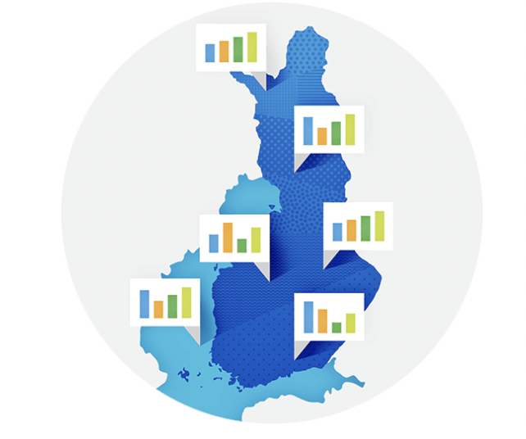
Networked Weather Data

Slide 5
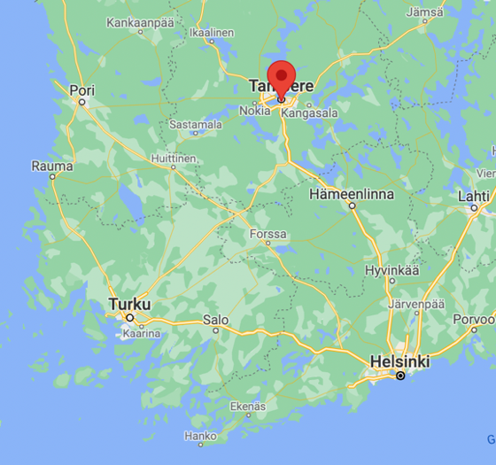

Slide 6
ImageNet
“…ImageNet is an image database organized according to the WordNet hierarchy (currently only the nouns), in which each node of the hierarchy is depicted by hundreds and thousands of images…”
https://image-net.org/

Slide 7
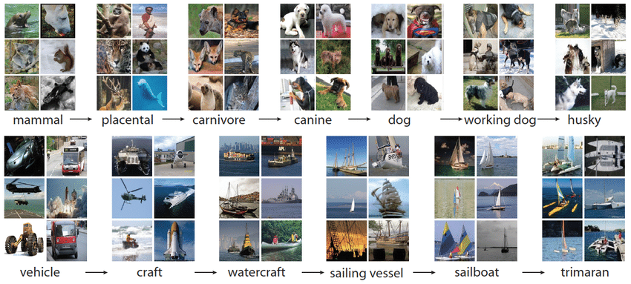
Devopedia. 2021. "ImageNet." Version 16, April 7. Accessed 2023-02-11. https://devopedia.org/imagenet

Slide 8
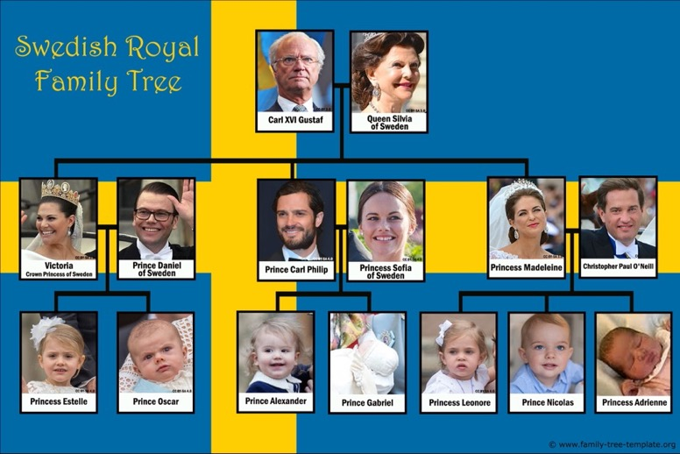
Noble Networks

Slide 9
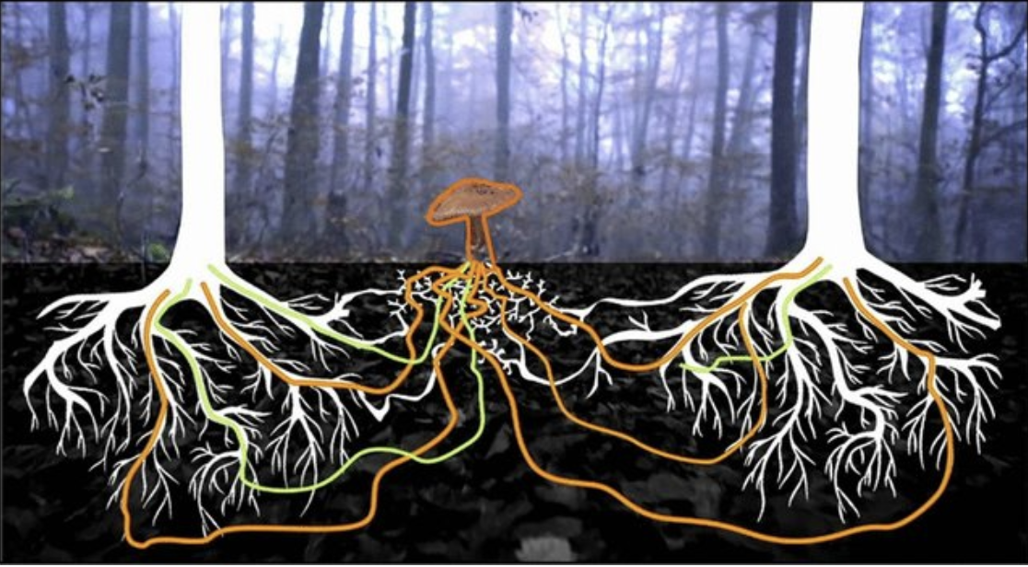
Wood Wide Net
Carreon, Hector & Valdez, Fevrier. (2022). A new mycorrhized tree optimization nature-inspired algorithm. Soft Computing. 26. 10.1007/s00500-022-06865-8.

Slide 10
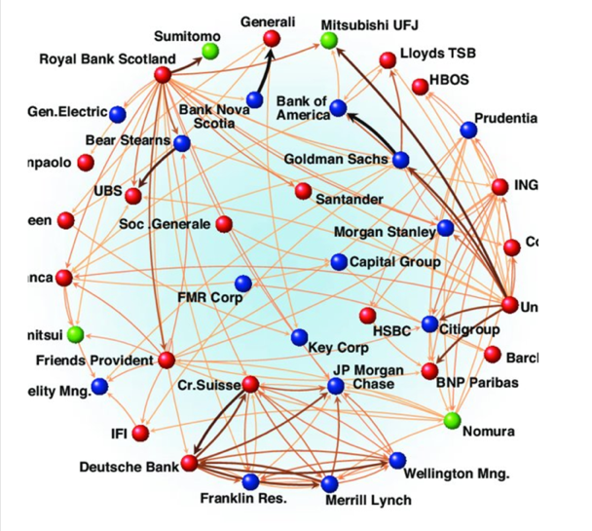
Finance Networks

Slide 11
Point Cloud Networks
label y
feature x

Slide 12
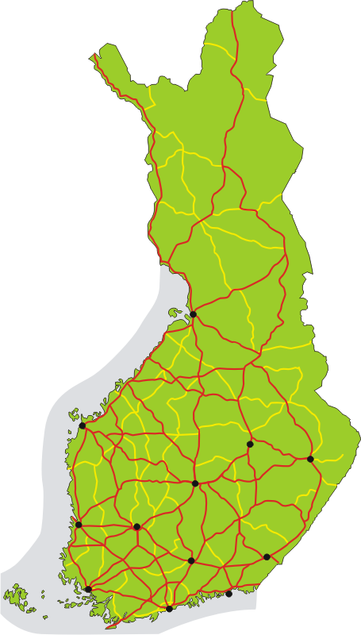
Road Network

Slide 13
Business Process
A
B
C

Slide 14
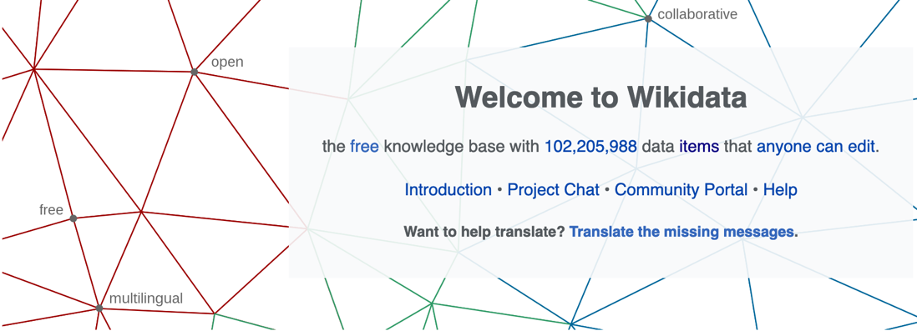
https://www.wikidata.org/wiki/Wikidata:Main_Page

Slide 15
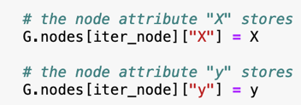
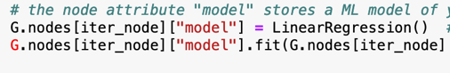
Empirical Graph
2
each node carries:
local dataset
local model
i=1
undirected edge indicate
“similarity”
3
4

Slide 16
Tuesday May 21, 2024, 8.00–12.00
08:00 - 08:50 What is a Network?
08:50 - 09:00 Break
09.00 - 09.50 Using Networks for Regularization

Slide 17
Clustering Assumption
local datasets often too small
let’s pool or cluster them but how ?

Slide 18
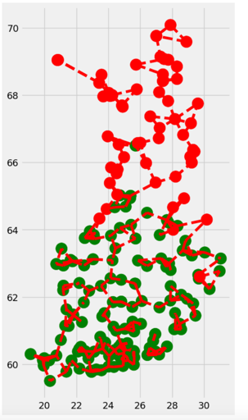
Clustering Assumption
the local datasets from clusters.
local datasets in same cluster c contain data points that can
be approximated as realizations of i.i.d. RVs with prob. dist p(x,y;c)

Slide 19
Cluster-Wise Training
pool local datasets of nodes in
same cluster to train ML model
the trained model is used at all nodes in same cluster
how to pool/cluster?

Slide 20
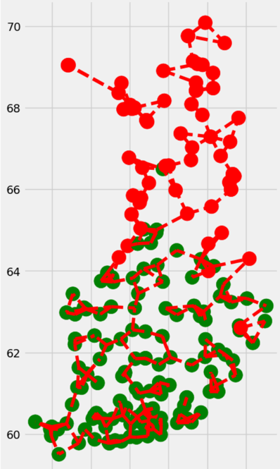
Clustering
compute avg. min and max
tmp for each station (node)
cluster using k-means
use same colour for stations in same cluster

Slide 21
Networked Models

Slide 22
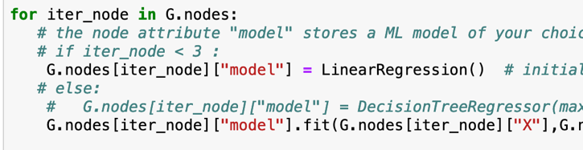
Option 1: Train Separately

Slide 23


Pro: Personalization

Slide 24

Con: Overfitting

Slide 25
Option 2: Global Model

Slide 26
Pro: No Overfitting

Slide 27
Con: Low Accuracy

Slide 28

Option 3: Clustered FL

Slide 29

Coupling of Local Models
coupling based on edges
local models at connected nodes should deliver similar predictions

Slide 30
Coupling via Regularization
node i
node j
local data
local model
local data
local model

Slide 31
Tuesday May 21, 2024, 8.00–12.00
08:00 - 08:50 What is a Network?
08:50 - 09:00 Break
09.00 - 09.50 Using Networks for Regularization
09.50 - 10.00 Break
10.00 - 10.50 Prob. Graphical Models

Slide 32
Tuesday May 21, 2024, 8.00–12.00
08:00 - 08:50 What is a Network?
08:50 - 09:00 Break
09.00 - 09.50 Using Networks for Regularization
09.50 - 10.00 Break
10.00 - 10.50 Prob. Graphical Models
10.50 - 11.00 Break
11.00 - 11.50 Federated Learning
11.50 - 12.00 Wrap Up

Slide 33
Any Questions ?

